Slide 1
Inventory Management System
by Hayden & Kate
Notes:
Welcome to our presentation, so Hayden & I built an app called Inventory Management System.

Slide 2
CONTENTS
01
Purpose
Tell you a bit about the app
02
Examples of code
Some snippets of code
03
Problems encountered
Issues we encountered
04
Website Demo
We will show you the website!
05
Notes:
In this presentation, We will tell you all about our app, share some code snippets, some problems we encountered and finally we will do a demonstration of our website.

Slide 3
Inventory Management System
What it does:
This app allows either a manager or employee of a store to sign up, log in and view an inventory of their products.
Functionality:
Sign up; as a manager or employee
Log in; as a manager or employee
Create, update or delete products
Edit; products name, price, quantity and category
Filter; products by name, price, quantity, category or id
Backend: Managers can delete users but employees can’t
this hasn’t been implemented into the front end

Slide 4
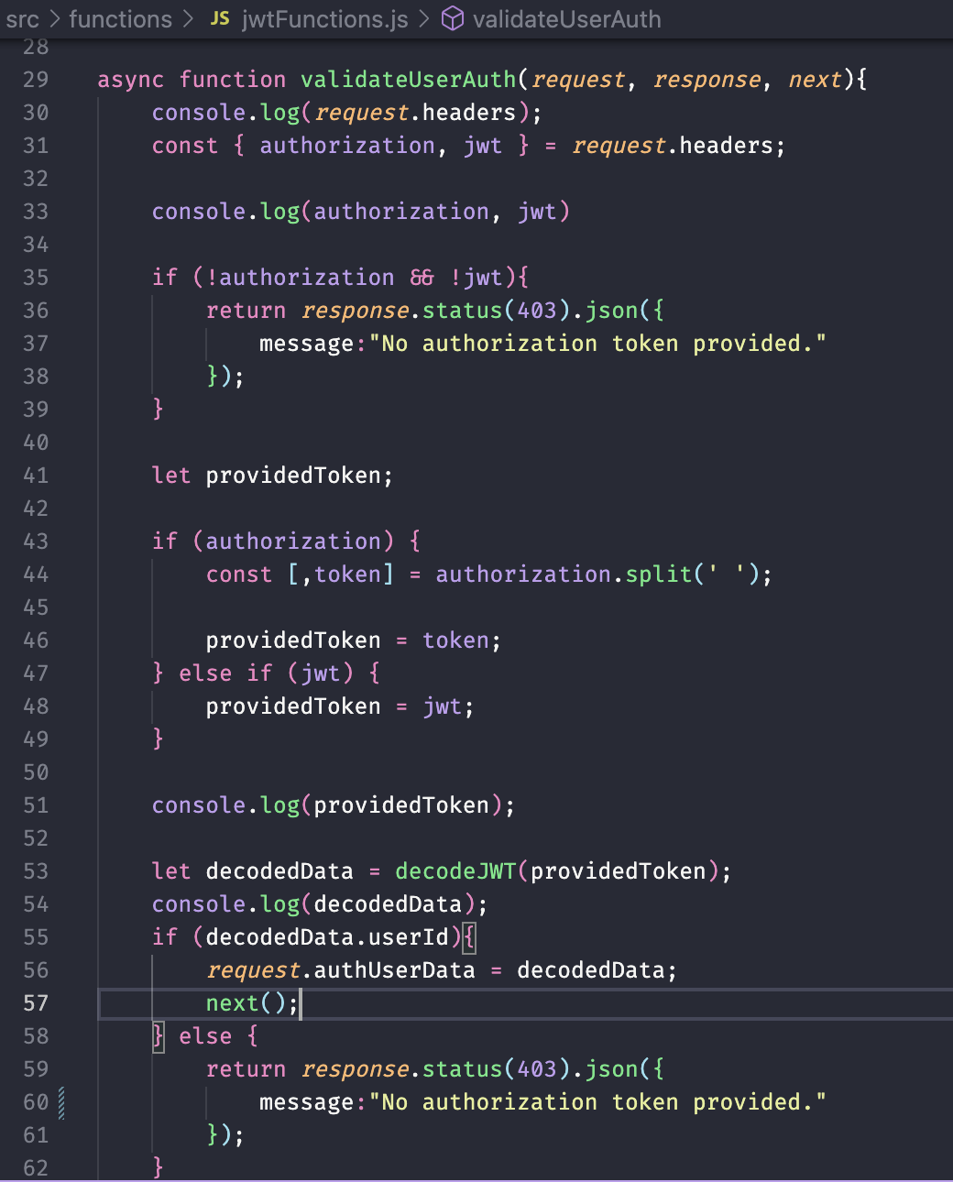
Example of a function:
validateUserAuth:
Checks if the user is logged in by
getting the token out of the jwt or authorization header, (t splits the authorization header and takes just the token part)
then it decodes the jwt to check the identity
If not logged in,
return message “No authorization token provided”
Notes:
KATE: Here I have a snippet of code from the backend, from the jwtFunctions file specifically, where I have a function that checks if the user is logged in with an error message being returned if they are not (logged in)
we were having issues with the jwt header so we made it so it accepts either authorization bearer or jwt token

Slide 5
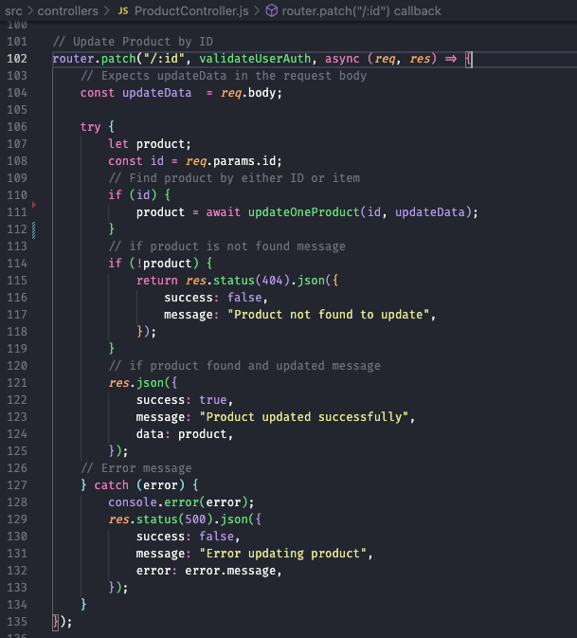
Example of conditional statement
Peep the previous function mentioned being called here
If product is not found, Return error message of “Product not found to update”
Notes:
KATE: Here is an example of a conditional statement, from the ProductController. In this section of code, it is getting the ID of the product and then allowing us to update the file, with conditional statements saying if product is not found, return a error message.
If product IS found and updated, it also returns a message.
You might also notice that the vaidateUserAuth function, which i mentioned in the previous slide, is being called at the top here also, to ensure that the user is logged in before updating the product.

Slide 6
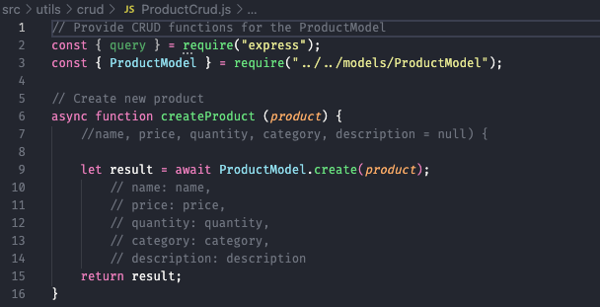
Example of database operations:
Create Product function in ProductCrud.js
Notes:
KATE: Database operation that create products
I created product object with the following things

Slide 7


More examples of database operations:
Update product
Delete product
Notes:
KATE: Some more examples we have a function that updates the product and one that deletes the product.

Slide 8
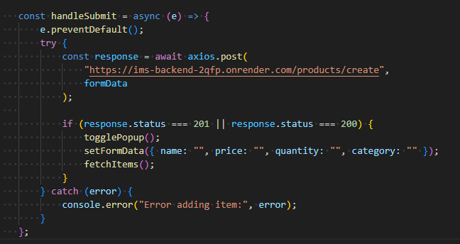
Example of network request:
Creating Products on the front-end.
Notes:
HAYDEN:

Slide 9
Problems encountered:
Price validator
tried to format the Price number into a monetary value
the validator I found online didn’t work
decided to render in the front-end instead.
Git merges
had conflicts merging,
put restrictions in place that meant a pull-request had to be required before merging to main
the dreaded misplaced comma
forgot a comma in one of the database operations
code wouldn’t work until rectified
JWT/Auth issues
edit & delete wouldn’t work
so made it so it accepted both JWT OR Authorization Bearer
Notes:
KATE:

Slide 10
Time to check out the website!
https://ims-hk.netlify.app/
Notes:
KATE: I’ll turn it over to Hayden now and he can demo the website! HAYDEN:

Slide 11
THANK YOU

